Slide 1

Sprint 4 Delivery

Slide 2

Table of contents
Current sprint
Pentest report
Finished webapp
Dmz access
Demo
Future sprint

Slide 3
Current sprint
Wrapped up pentest
Completed Web Application
Received DMZ access
Preparing to conclude project

Slide 4
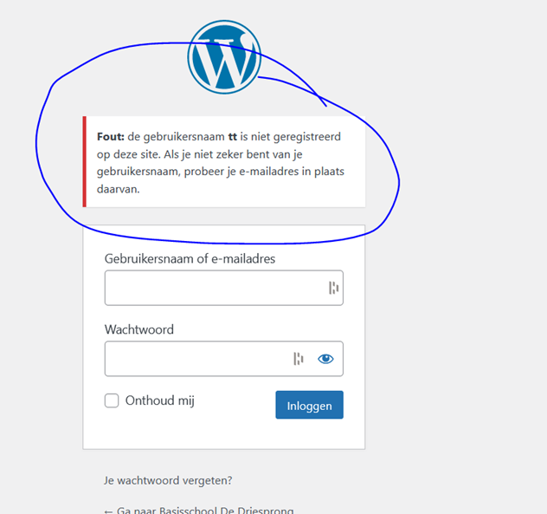
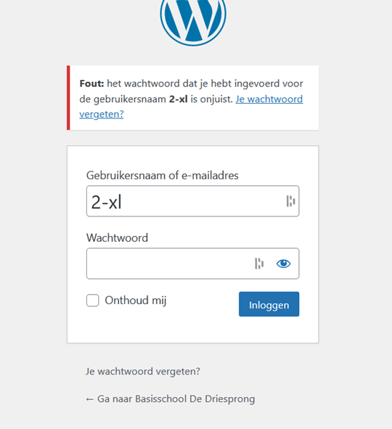
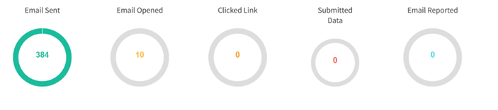
Pentest Report
Onderwijsstichting Triade, 13th to 15th of May.
Wordpress miss-configs like: open xml-rpc, pulblic wp-rest api, username enumeration on login, no bruteforce protection
Phishing campaign
No rate

Slide 5
Finished Webapp
Fully functional registering and logging in.
Design in-line with other pages
Both pages partially vulnerable.
I'll add screenshots here later

Slide 6
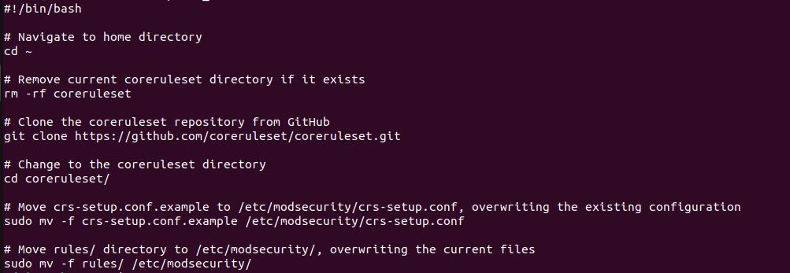
Finished Web Application Firewall
Setup Crontab
Automated Core ruleset script

Slide 7

DMZ Access
Environment is being built
Internet access to outside working
Testing out ansible scripts for rebuilding the environment

Slide 8

Future sprint
Refine project now that it's on the DMZ
Conclude with fully-fledged demo and presentation

